Slide 1
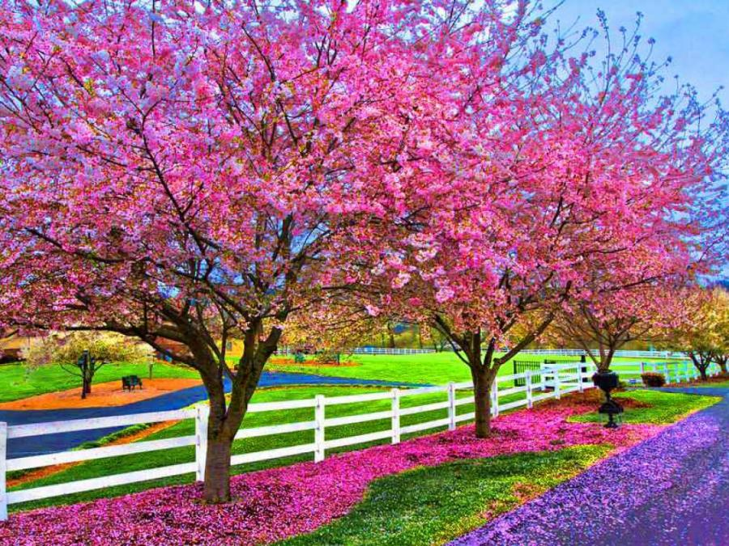
Good morning students.

Slide 2
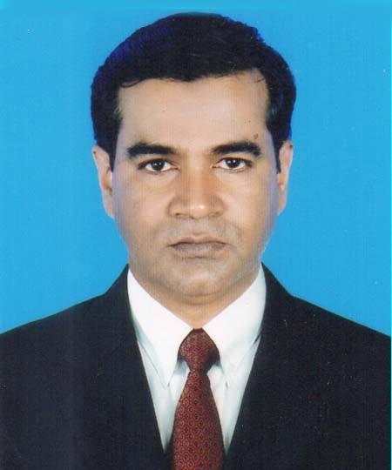
Presented by
Md. Anamul Huq
(Assistant teacher)
Madna govt primary school.
Lakhai, Habigonj.
Phone: 01716-806098
Class: Five
Subject: English
Unit: 21(It was a great day)
Lesson: Last -----our tents.
Time: 45 minute

Slide 3
Learning outcomes
By end of the lesson student will be able ------
1.To read the text with proper pronunciation.
2.To make sentences using words.
3.To write a short paragraph by answering a set of
questions.

Slide 4
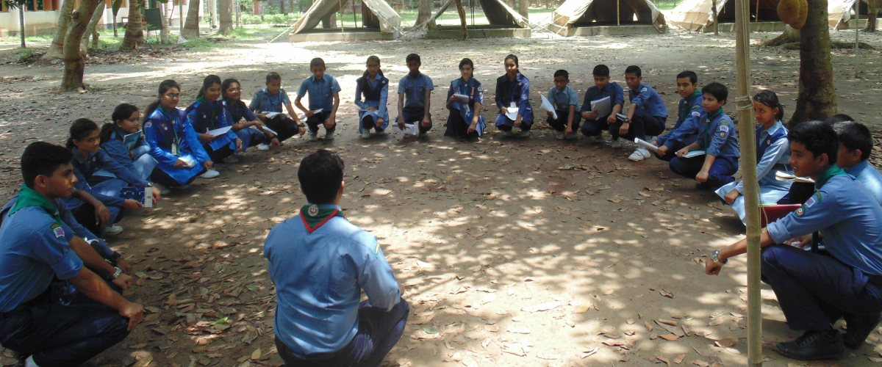
cub camporee
What’s this?
It’s a cub sign.
What can you see in the picture?
Last January I went to a cub camporree. It was my first visit to a cub camporee and it was my first time away from home.

Slide 5
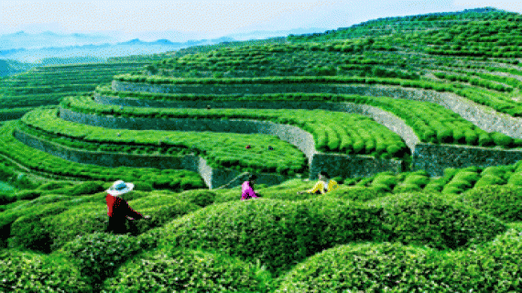
Sreemangal
Do you know the place?
The cub camporee took place in Sreemangal.

Slide 6
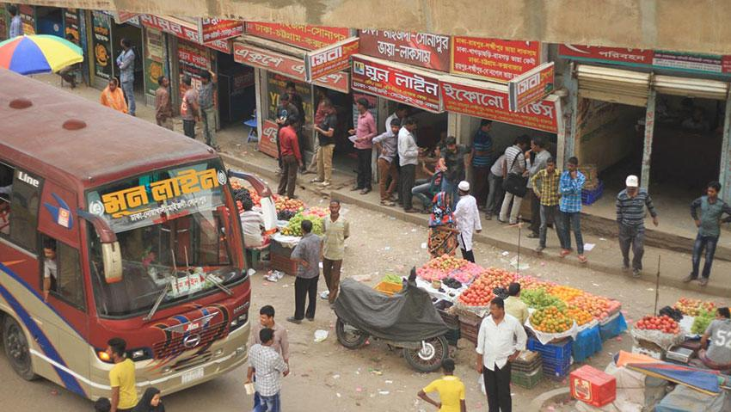
Dhaka to Sylhet
To get there, we first travelled from Dhaka to Sylhet.

Slide 7
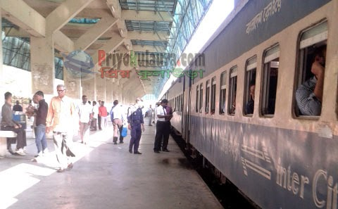
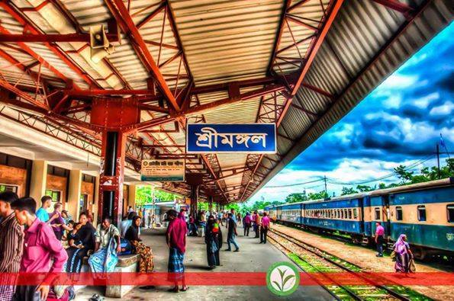
Sylhet railway station
From Sylhet, We took a train to Sreemanngal. We arrived in the morning.

Slide 8
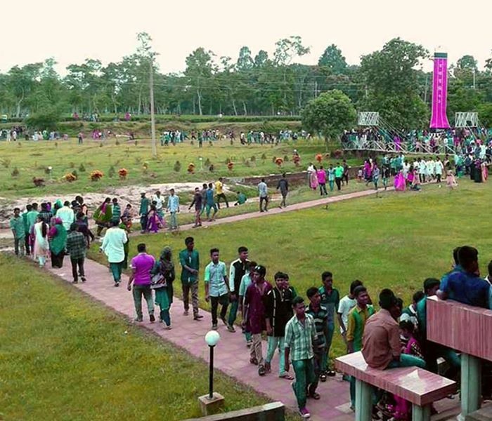
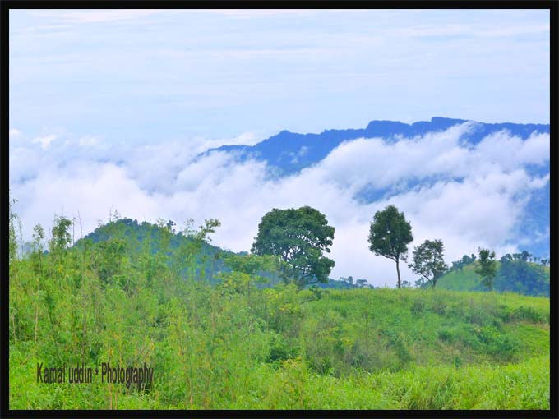
We walked to our camp from the train station. There were 10 of us and two leaders.It wasn’t very far.
The weather was nice..

Slide 9
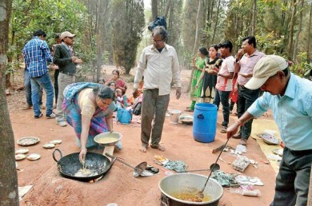
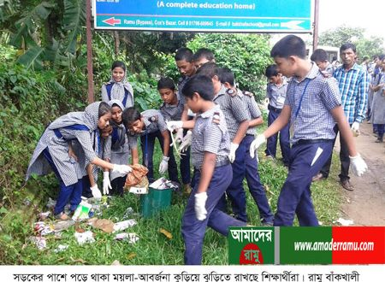
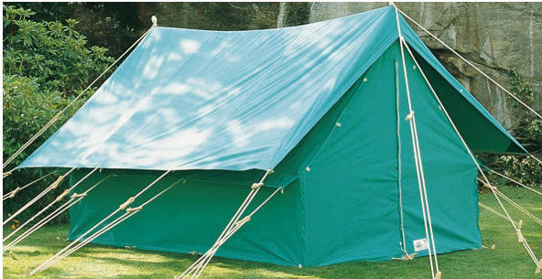
Set up our tents.
Prepared our breakfast.
We cleaned up area.

Slide 10
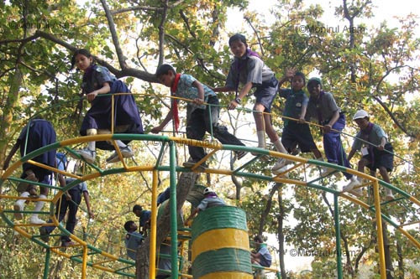
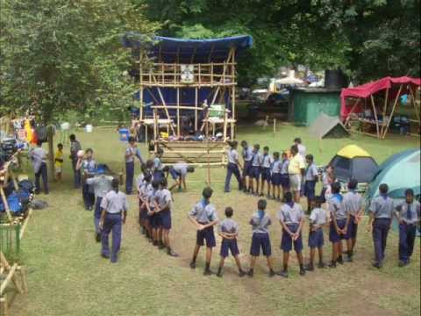
We play games.

Slide 11
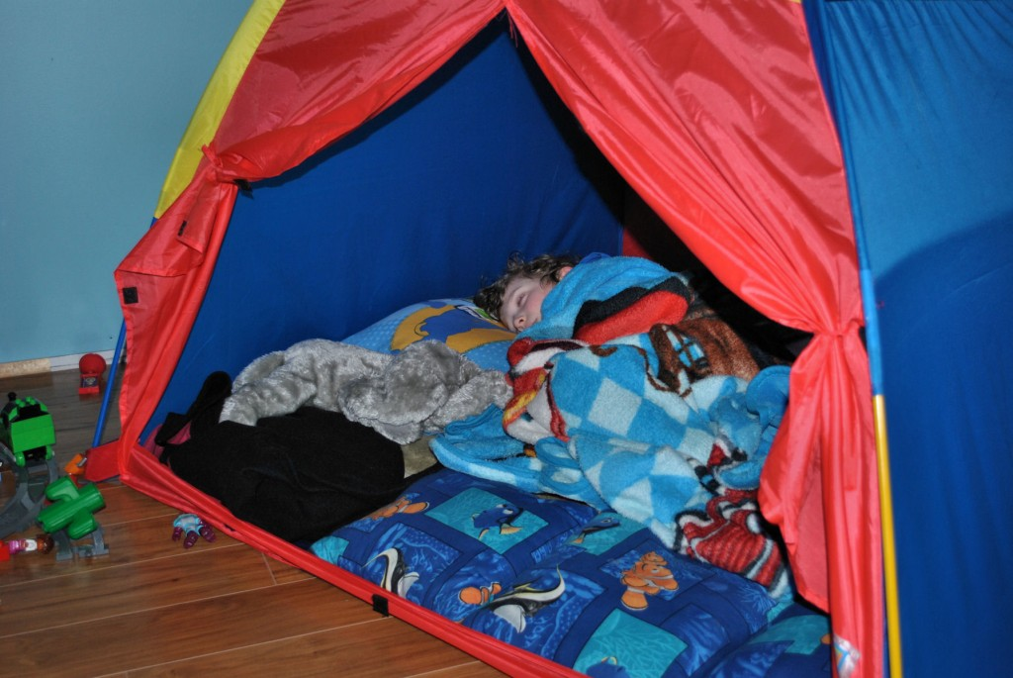
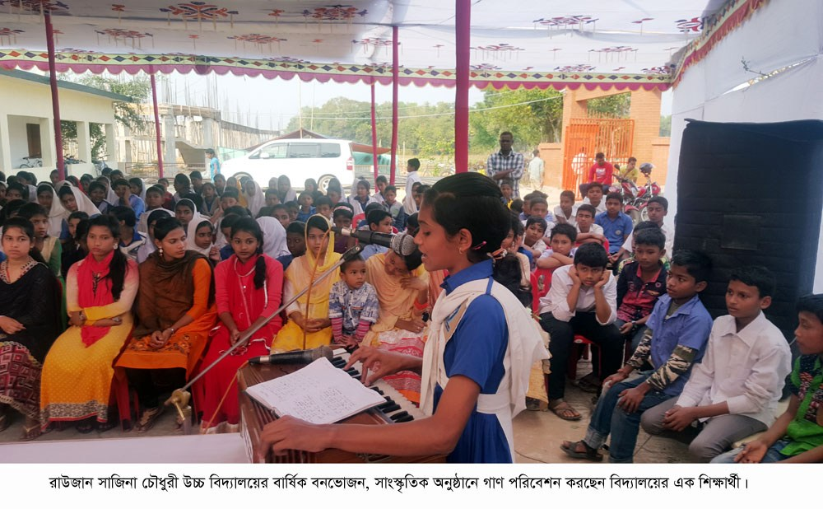
We sang songs and recited poems.
At night, we slept in our tents.

Slide 12
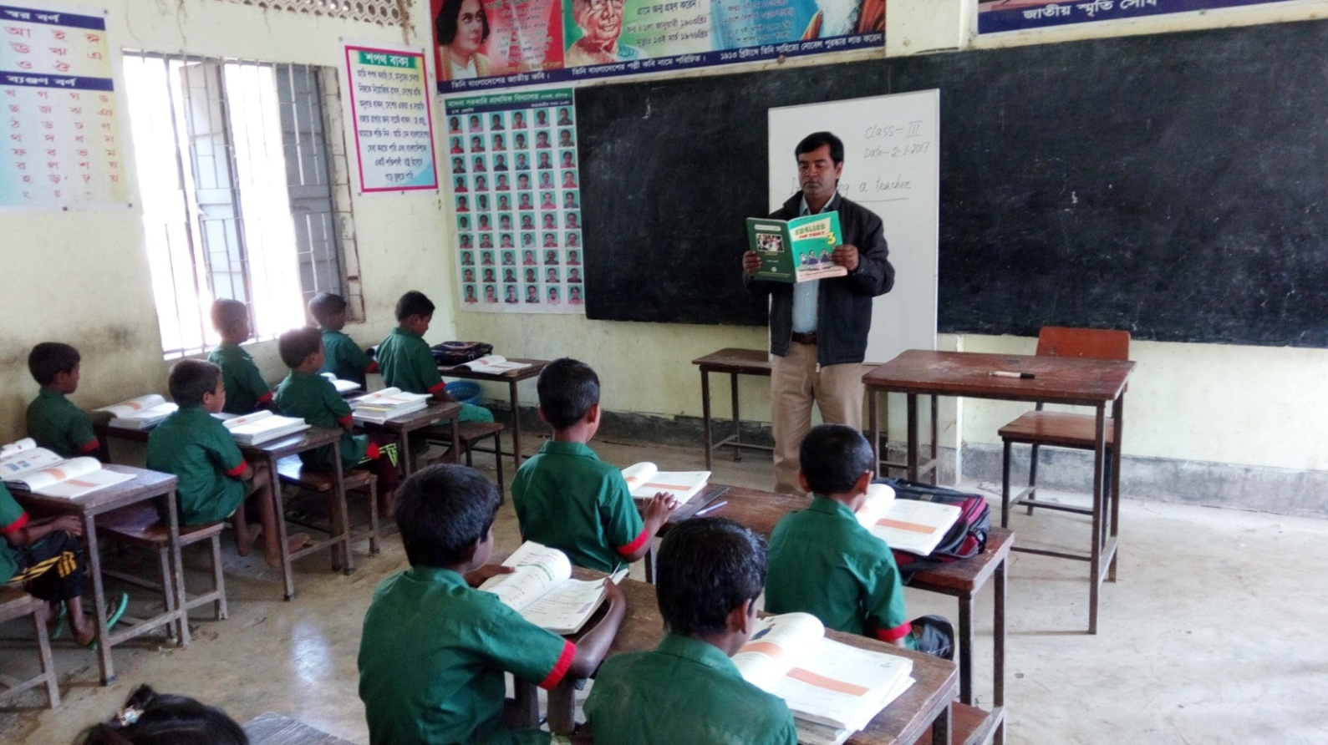
Teacher’s loud reading and discuss the lesson.

Slide 13
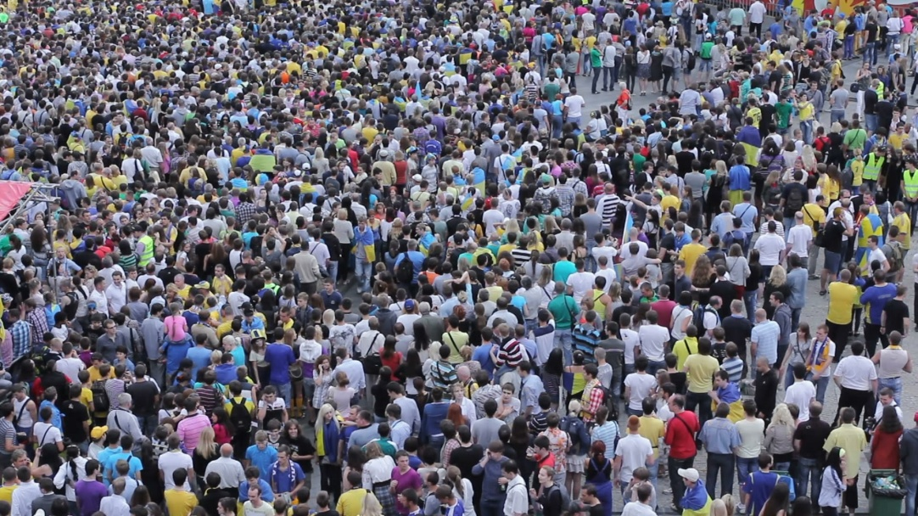
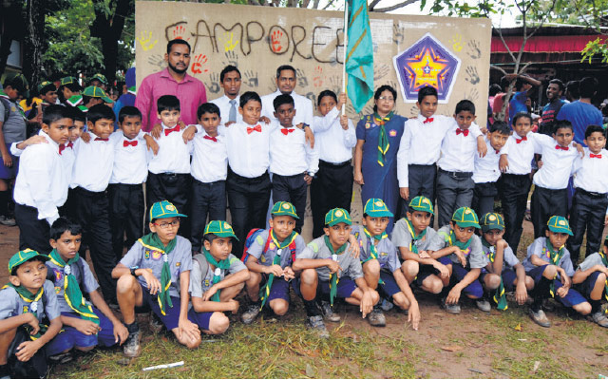
New words with sentences by using picture
To come together
clearing
Council
Cleaning
Camporee
Gathering
I went to a cub camporee.
They are cleaning the camp.
They are gathering from different places of Bangladesh.

Slide 14
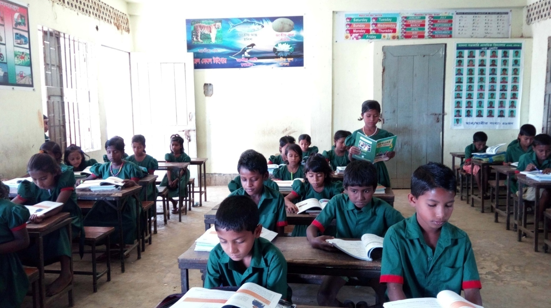
Student’s loud reading help by teacher.

Slide 15
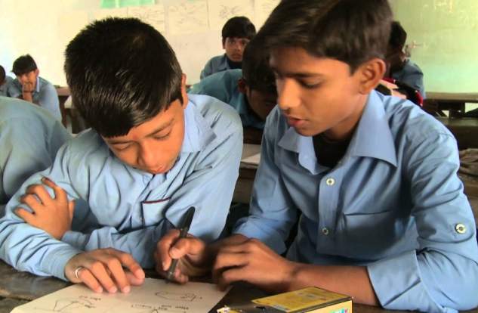
Pair work
Write a short composition on “Cub camporee” at least five sentences by answering
The following questions .
What is a cub camporee?
(b) Have you ever been to a cub camporee?
(c) What did you do in the morning of the first day?
(d) How did you enjoy your program?
(e) How did you end your program?

Slide 16
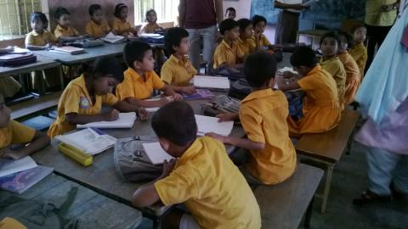
Group work
G -1. How did the team go to sreemamgal?
G-2. What did the team members do after breakfast?
G – 3. What did they do in the evening?

Slide 17
Evaluation
Match the answer
Write only the answer on the answer paper
1.When did the speaker go to a cub camporee?
✓
(a) Last january
(b) Last march
(c) Last may
(d) Last december
2. The team had---------
✓
(a) 9 members
(b) 11 members
(c) 10 members
(d) 100 members
3. What did they do at first ?
✓
(a) Cleaning
(b) Walking
(c) Cooking
(d) Firing
4.When did they reach?
✓
(a) In the evening
(b) In the morning
(c) At noon
(d) At night

Slide 18
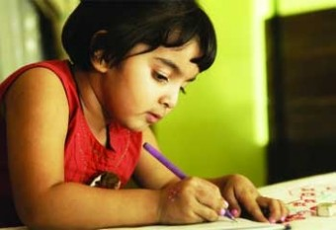
Home work
You will write five sentences about your holiday activity.

Slide 19
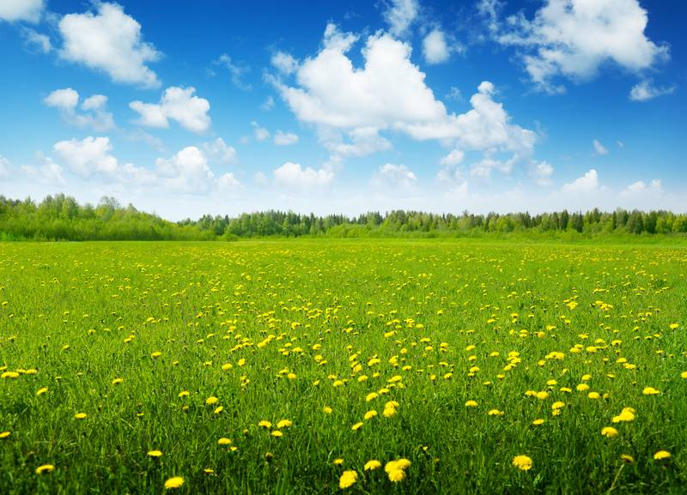
Thank you everybody
See you again.
Bye ---- Bye.

